Slide 1
FINANCE – Office of Research Grants and Contracts
Preparing Your Budget
Kevin Goggin, Research Support Officer

Slide 2
Agenda – Session 1
Contents:
1. Compliance! Compliance! Compliance!
2. Pay Costs
3. Equipment Costs
4. Other Costs
5. Direct Costs versus Indirect Costs
6. VAT
7. Q & A

Slide 3
Agenda
Contents:
1. Compliance! Compliance! Compliance!
2. Pay Costs
3. Equipment Costs
4. Other Costs
5. Direct Costs versus Indirect Costs
6. VAT
7. Q & A

Slide 4
1. Compliance! Compliance! Compliance! Compliance with…..
Funding Body Rules & Guidelines:

Slide 5
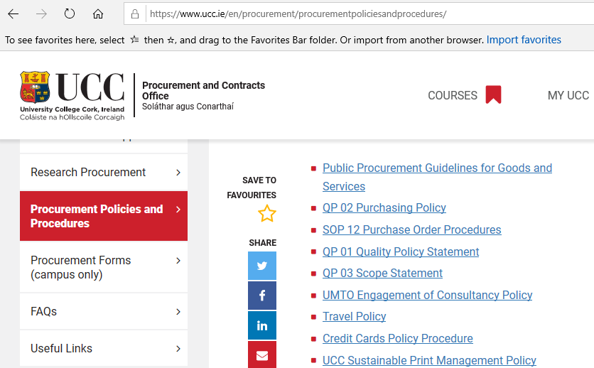
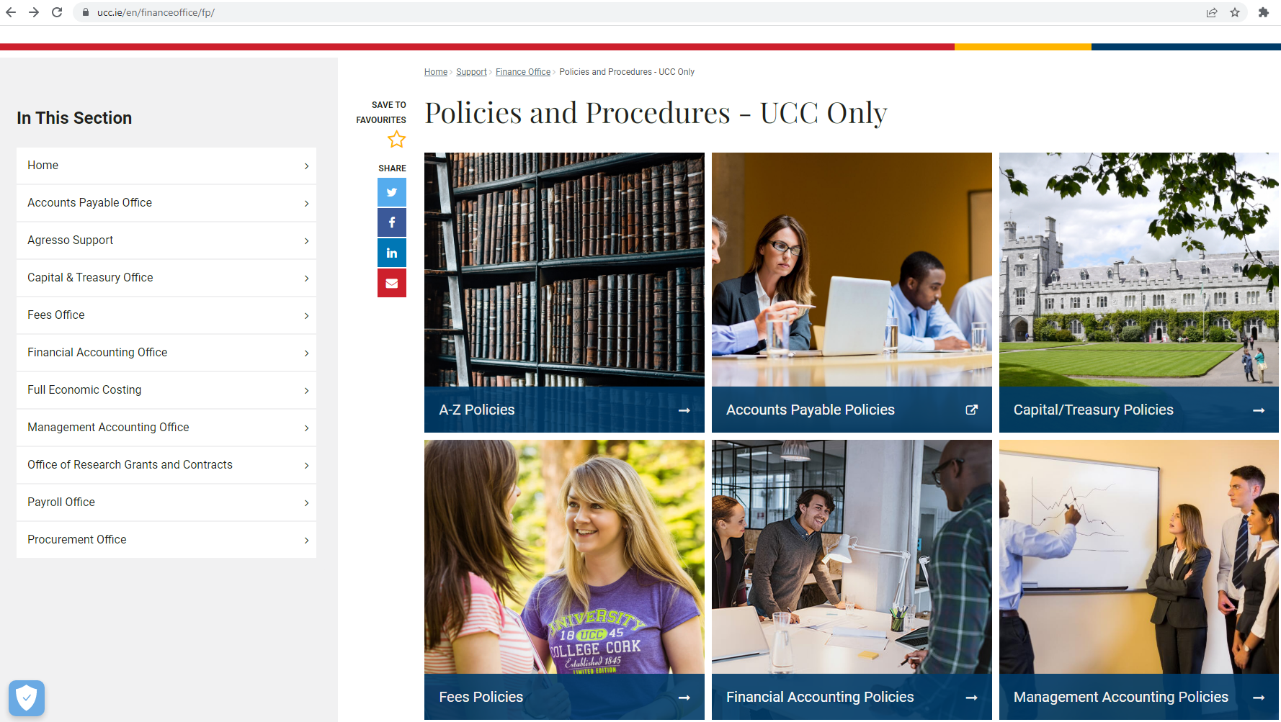
1. Compliance! Compliance! Compliance! Compliance with…..
UCC Policies & Procedures:
UCC Procurement Policies & Procedures:
https://www.ucc.ie/en/procurement/procurementpoliciesandprocedures/
UCC Finance Office Policies & Procedures:
https://www.ucc.ie/en/financeoffice/fp/

Slide 6
1. Compliance! Compliance! Compliance! Compliance with…..
Local regulatory compliance –Taxation and all Legal compliance:

Slide 7
1. Compliance! Compliance! Compliance! Compliance with…..
UCC Research Procedures:
When preparing a research project budget:
UCC Research are always first point of contact and will co-ordinate your communication with Finance and any other departments, e.g. OCLA
Read the Call Documentation – Eligible cost rules
Interpret and understand:
What costs can be claimed
Is there an allowance to claim indirect costs / overheads
How costs are calculated
What amount / % of costs are reimbursed / Is match funding required?
Submit your budget for Finance Office review no later than 5 working days pre-submission of application

Slide 8
Agenda
Contents:
1. Compliance! Compliance! Compliance!
2. Pay Costs
3. Equipment Costs
4. Other Costs
5. Direct Costs versus Indirect Costs
6. VAT
7. Q & A

Slide 9
2. PAY Costs
QUESTION?
UCC hires a staff member with an annual salary of €24,000 on the 01-JAN-2023. What will be the cost of that employee be to UCC for the 12 month period to 31-DEC-2023?
€24,000
€32,222

Slide 10
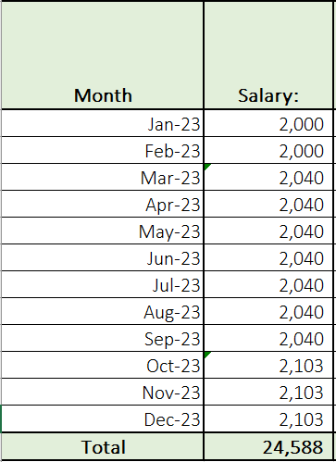
2. PAY Costs

Slide 11
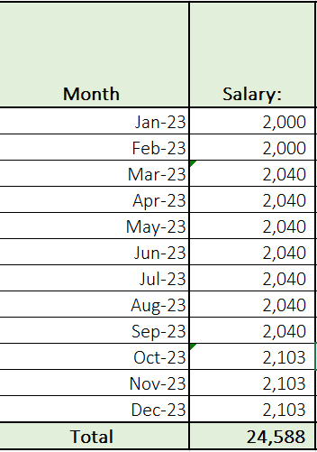
2. PAY Costs

Slide 12
2. PAY Costs Multi Year Forecasts
When considering multi-year forecasts what needs to be considered?
Know salary scale adjustments
Unknown salary scale adjustments
Annual pay scale movements
QUESTION?
UCC are currently preparing a budget for a new Horizon Europe project of 5 year duration? The project will require the recruitment of a Research Assistant to work full time on the project. The projects is expected to commence on 01-Jan-2023. How much should we forecast for the Research Assistant Pay costs?

Slide 13
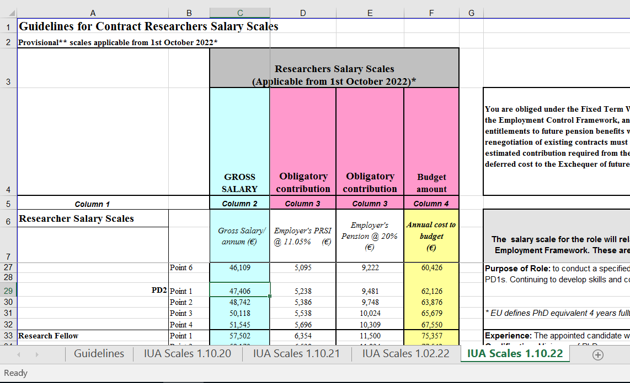
2. PAY Costs Multi Year Forecasts
As staff member will commence post 01-JAN-2023 then the relevant scales from the UCC / IUA website should be used
The IUA website features current and future agreed pay scales

Slide 14
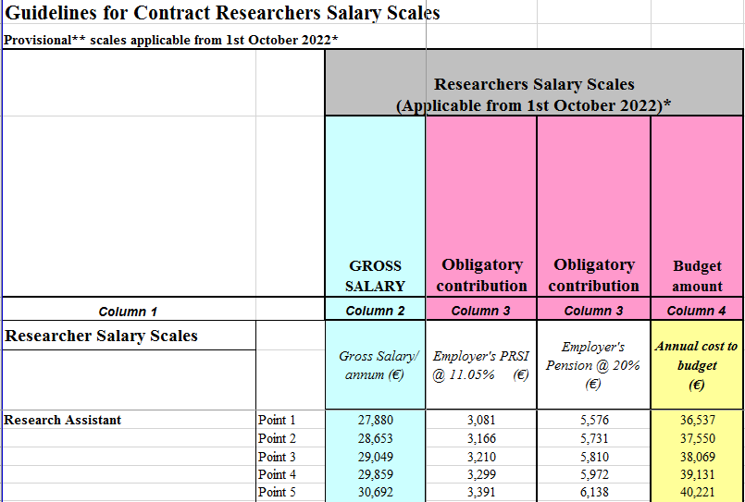
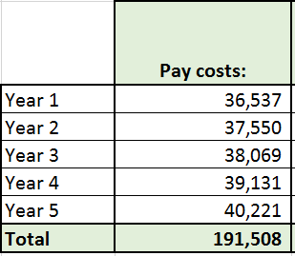
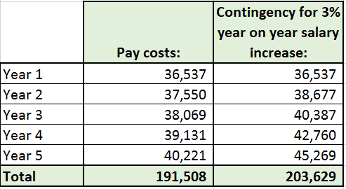
2. PAY Costs Multi Year Forecasts
In the interest of prudence pay cost forecasts, where possible, should include a 3% year on year inflationary pay increase.
The staff member will move up one point on the salary scale on each anniversary of the employment commencement date!

Slide 15
2. PAY Costs Useful Links
UCC Salary Scales (Research & Non Research):
https://www.ucc.ie/en/hr/salaryscales/
IUA -University Research Salary Scales/Guidelines (Reflecting known future increases):
https://www.iua.ie/for-researchers/researcher-salary-scales-career-framework/
DCU Pay Cost Forecasting tool:
https://salarycalculator.adaptcentre.ie/

Slide 16
Agenda
Contents:
1. Compliance! Compliance! Compliance!
2. Pay Costs
3. Equipment Costs
4. Other Costs
5. Direct Costs versus Indirect Costs
6. VAT
7. Q & A

Slide 17
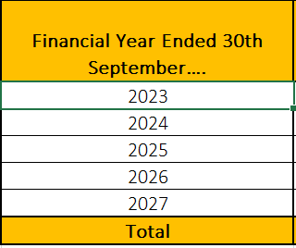
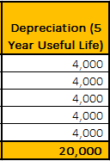
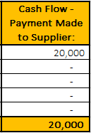
3. Equipment Costs Depreciation versus Cash Flow
Annual Depreciation: Cost of Asset (€20,000) divided by Useful Life of Assets (5 years)
Cash Flow Impact: The supplier of the assets is paid (€20,0000) in full in the year of acquisition of the asset
NOTE: Depreciation method applies to some funding agencies, e.g. EU, EPA & SEAI. Other funding agencies may have Depreciation / Equipment cost claim rules, e.g. Allow to claim full purchase price of equipment, so budgets & claims would have to be calculated accordingly.

Slide 18
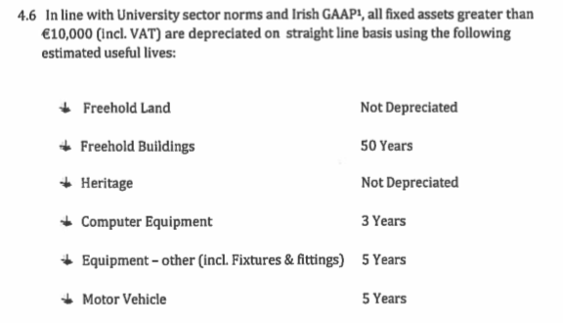
3. Equipment Costs
Extract from “UCC Fixed Asset Policy & Procedures”:

Slide 19
3. Equipment Costs EU Horizon Europe Example - Budget
UCC are participating in an EU HEurope funded project
The project requires purchase of non-IT equipment costing €20,000
The project will commence on 01-JAN-2021 and will be of a 5 year duration
The budget assumes that the equipment required for the project will be acquired on the first day of the project
The equipment was actually delivered to UCC with an accompanying invoice on 01-JUL-2021

Slide 20
3. Equipment Costs EU Horizon Europe Example - Budget
€2,000 has be funded from alternative source, e.g. project overheads / departmental budget

Slide 21
3. Equipment Costs When to acquire an asset?
Key Message:
To maximise funds when claims are based on Depreciation, be sure to purchase equipment as early as possible in the project life.

Slide 22
3. Equipment Costs
UCC Fixed Asset Policy & Procedures:
https://www.ucc.ie/en/media/support/financeoffice/otherdocuments/FixedAssetPolicyProcedures2021.doc

Slide 23
Agenda
Contents:
1. Compliance! Compliance! Compliance!
2. Pay Costs
3. Equipment Costs
4. Other Costs
5. Direct Costs versus Indirect Costs
6. VAT
7. Q & A

Slide 24
4. Other Costs
Ensure that all costs are included to ensure that project / activity can be completed successfully…subject to the eligibility rules of the funding agency!
Include but not limited to:
Travel:
Refer to UCC policy for guidelines on rates to be applied, https://uccireland.sharepoint.com/sites/accounts-payable-ucc/SitePages/Travel-%26-Expenses-Policy.aspx
Consumables
Dissemination, Publication and Open Access costs
Audit Fees:
Is the research project subject to Audit? (e.g. Horizon Europe projects with a claim value €430k are subject to audit. Guideline costs are €2,000 per annum but this can vary depending on the total claim value – Refer to finance for guidance on forecast value)

Slide 25
Agenda
Contents:
1. Compliance! Compliance! Compliance!
2. Pay Costs
3. Equipment Costs
4. Other Costs
5. Direct Costs versus Indirect Costs
6. VAT
7. Q & A

Slide 26
5. Direct Costs versus Indirect Costs What are they?
"Indirect costs" are costs which are necessary for implementing the project, but are not "directly" linked to it (because their share in the project cannot be exactly established).
Examples thereof are:
Office of the Vice President for Research
Computing
Energy
Cleaning
Insurance
Space
Minor works
Post
Grounds
Human Resources
Finance
Library
Security
Secretarial
In Research Projects these costs can be recovered, where applicable/ allowable, via an “Overheads” charge

Slide 27
5. Budgeting for Indirect Costs Questions for Consideration
Key question:
How much “Overheads” (Indirect Costs) should I include in my budget / can I charge to a funding agency?

Slide 28
5. Direct Costs versus Indirect Costs Questions for Consideration
How much “Overheads” (Indirect Costs) should I include in my budget / can I charge to a funding agency?
This will be determined by:
The rules determining what % can be earned and what are eligible costs to which this % can be applied, where applicable, as set out by the relevant funding authority, e.g. Horizon Europe = Normally 25% of “eligible” costs.
UCC Research Overheads Rates Policy (https://www.ucc.ie/en/media/research/researchatucc/documents/OverheadRatesPolicy.FINAL(1).pdf)
Parameters for determining overhead rate (30% to 100%):
Foreground IP Ownership
Partner – Enterprise type / size
Partner Licensing Terms
Desk Based versus Lab Based Research

Slide 29
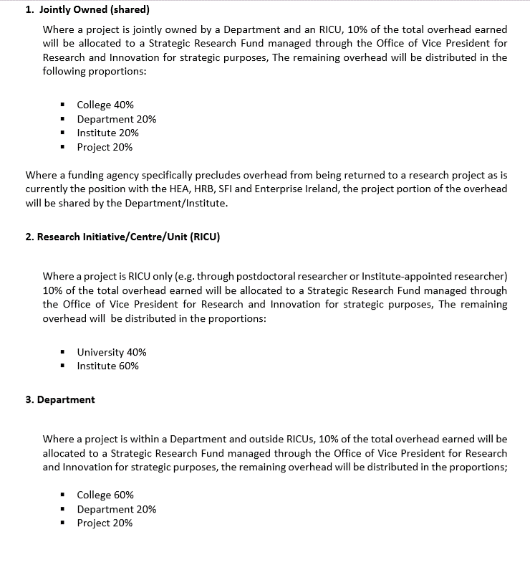
5. Direct Costs versus Indirect Costs Questions for Consideration
Where will the “Overheads” income be recognised?
This will be determined by:
UCC Contract Research Overhead Distribution Policy:
https://www.ucc.ie/en/media/support/financeoffice/orgc/Contract_Research_Overhead_Distribution_Policy_Oct2014.pdf

Slide 30
Agenda
Contents:
1. Compliance! Compliance! Compliance!
2. Pay Costs
3. Equipment Costs
4. Other Costs
5. Direct Costs versus Indirect Costs
6. VAT
7. Q & A

Slide 31
6. VAT (Value Added Tax)
QUESTION?
Does the VAT status of my research project impact on the resources available to me?
YES!! It can impact….
the amount of research income available to fund project activities, and,
the value of expenses incurred in the project.
VAT is mainly a concern in Industry funded research activities

Slide 32
6. VAT (Value Added Tax)
If your project is….. | VATABLE | NON-VATABLE
Income | We must pay Irish Revenue VAT on Research Income generated | We do not pay Irish Revenue VAT on Research Income generated
Expenditure | We can reclaim VAT on expenditure incurred on a Research Project (i.e. Expenses are incurred NET of VAT) | We can reclaim VAT on expenditure incurred on a Research Project (i.e. Expenses are incurred inclusive of VAT)

Slide 33
6. VAT (Value Added Tax) When are Research services Vatable?
Activities not regarded as exempt educational activities

Slide 34
6. VAT (Value Added Tax)
Revenue Guidelines on VAT for University Research Activities:
https://www.revenue.ie/en/tax-professionals/tdm/value-added-tax/part03-taxable-transactions-goods-ica-services/Services/services-third-level-educational-bodies-research.pdf
VAT ISSUES / QUERIES – RESEARCH SUPPORT SERVICES ARE FISRT POINT OF CONTACT !!!!!

Slide 35
Agenda
Contents:
1. Compliance! Compliance! Compliance!
2. Pay Costs
3. Equipment Costs
4. Other Costs
5. Direct Costs versus Indirect Costs
6. VAT
7. Q & A

Slide 36
BACK UP SLIDES

Slide 37
FINANCE – Office of Research Grants and Contracts
Research Support……”Who, What, Where, When?”
Kevin Goggin, Research Support Officer

Slide 38
Who and where?
Main Finance Office, North Wing
Name | Role / Funding Body
Mary Cusack | Research Accountant
Caitriona Doyle | Deputy Research Accountant
Joanne O’Sullivan (On leave) | Financial reports & grant administration - EU; Enterprise Ireland annual overhead queries; General research queries. (Currently on Leave - contact Erica Constant)
Kevin Goggin | Budget & Application Review, Horizon Europe & Others
Margaret O’Connell | Horizon Europe and Horizon Europe Reporting - Financial Reporting Support for Horizon 2020 and Horizon Europe projects; Financial reports & grant administration - EU
Caitriona O’Leary | Financial reports & grant administration - EU, Marine Institute; General research queries
Lillian Guerin | Health Research Board, Irish Research Council

Slide 39
Who and where?
Main Finance Office, North Wing
Name | Role / Funding Body
Erica Constant | Financial reports & grant administration - EPA, EU, Interreg, Wellcome Trust, Cancer Research Ireland; General research queries
Maria Buckley | Allocating research income; Research bank account; Debtors; Journal processing; General research queries
Catherine Donovan | Financial reports & grant administration - HEA, EI and Teagasc; Other general research queries
Maeve Nagle | Grant administration; Opening non-SFI research accounts (Currently on Leave)
Alice O’Leary | Research employment contracts, amendments, renewals etc. Post Proposal forms; Once-off Payment Authorisation forms; Ad hoc payroll requests
Mary Aherne | Allocating research income; Research bank account; Debtors; Research VAT queries; VIES Revenue return

Slide 40
Who and where?
Main Finance Office, North Wing
Name | Role / Funding Body
Natalie Bennett | Financial reports & grant administration; General research queries
Rachel Murphy Coughlan | Research expense claim & travel advances; Once-off Payment Authorisation forms; Ad hoc research payroll requests
Geraldine Ahern | Grant administration; General research queries

Slide 41
Who and where?
Kane Building Annex - SFI
Name | Role / Funding Body
Sean Ahern | SFI Accountant
Tim O’Mahony | SFI Reporting
Roisin Campbell | SFI Centres
Conor Dowd | SFI Reporting
Rozy Gay | SFI Reporting

Slide 42
What?
Completion
Management of closing balances and research account closure
Application
Budget preparation and review
Award
Contract review, account administration & treasury
Administration & Compliance
Claims management & Budgetary / financial compliance.

Slide 43
What? : Application
Assist with budget preparation
Review of proposed budgets prior to submission, reviewing for:
Compliance
Completeness
Accuracy
Taxation status
Application

Slide 44
What? : Award
Financial review of legal agreement, e.g. Consortium Agreements, Sub-contract agreements
Opening of research accounts (R-codes)
Determine Overhead Distribution allocation %
Set up project treasury processes
Award

Slide 45
What? : Administration & Compliance
Prepare research financial claims / invoices
Allocate earned overheads
Review / approve research expense claims
Review / approve funding for research employment contracts
Audit management / Liaison with external auditors
Control research debtors and allocation of research income
Management Reporting /Address internal & external ad hoc queries and requests
Administration & Compliance

Slide 46
What? : Completion
Prepare final research financial claims / invoices
Accounting for any surplus / deficits on completed projects
Closure of research accounts
Completion

Slide 47
When?
Proposal / Application stage, with RSS co-ordination:
To request budget templates
To seek guidance on budget preparation
For review of budgets prior to submission….but no later than 5 days prior to the application deadline
Claim / Invoice stage
Requesting of budget reallocations
Preparing research finance related information requests

